Slide 1
Chapter 4: The nervous system is highly organised

Slide 2
4.1 Central nervous system
The central nervous system (CNS) consists of the brain and spinal cord and is where incoming messages are processed and outgoing messages are initiated.
Protection of the CNS
Three structures protect the CNS:
• bone
• membranes called meninges
• cerebrospinal fluid.
Cranium and vertebrae
The outermost protective layer is bone. The brain is protected by the cranium, the part of the skull that houses the brain, while the spinal cord runs through the vertebral canal, an opening in the vertebrae.
These bones provide a strong, rigid structure to protect the structures underneath.

Slide 3
4.1 Central nervous system
Meninges
Inside the bones, and covering the entire surface of the CNS, are three layers of connective tissue forming membranes called the meninges.
The outer layer, the dura mater, is tough and fibrous, and therefore provides a layer of protection for the brain.
The middle layer, the arachnoid mater, is a loose mesh of fibres.
The inner layer, the pia mater, is far more delicate. It contains many blood vessels and sticks closely to the surface of the brain & spinal cord.

Slide 4
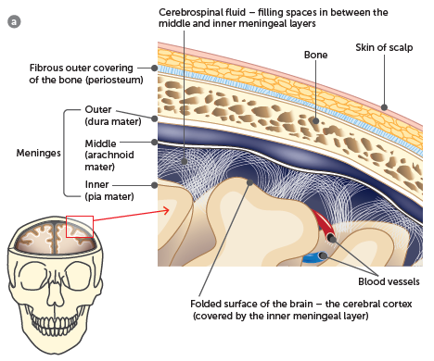
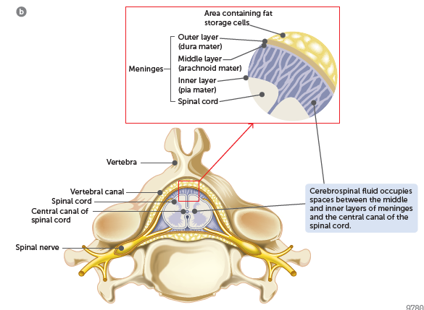
4.1 Central nervous system
a Structures that protect the brain; b Structures that protect the spinal cord

Slide 5
4.1 Central nervous system
Cerebrospinal fluid (CSF)
CSF occupies a space between the middle and inner layers of meninges. It also circulates through cavities in the brain and through a canal in the centre of the spinal cord. The CSF is a clear, watery fluid containing a few cells and some glucose, protein, urea and salts.
The CSF has three functions:
Protection: the CSF acts as a shock absorber, cushioning any blows or shocks the CNS may sustain.
Support: the brain is suspended inside the cranium and floats in the fluid that surrounds it.
Transport: the CSF is formed from the blood, and circulates around and through the CNS before eventually re-entering the blood capillaries. During its circulation it takes nutrients to the cells of the brain and spinal cord and carries away their wastes.

Slide 6
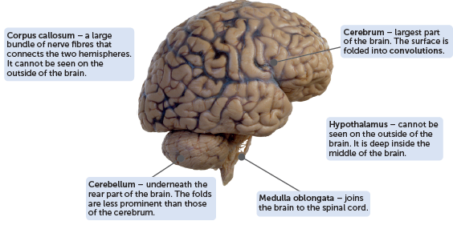
4.1 Central nervous system
The brain
The brain is a very complex organ, both in structure and function.
Alamy Stock Photo/Science Photo Library
External view of the brain

Slide 7
4.1 Central nervous system
Cerebrum
The cerebrum is the biggest part of the brain and consists of an outer surface about 2–4 mm thick of grey matter known as the cerebral cortex. The grey matter consists of neuron cell bodies, dendrites and unmyelinated axons. Below the cortex is white matter, which is made up of myelinated axons. Deep inside the cerebrum is additional grey matter called the basal ganglia.
The cerebral cortex is folded in patterns that greatly increase its surface area. In this way the cortex contains 70% of all the neurons in the central nervous system. The folding produces rounded ridges called convolutions. The convolutions are separated by either shallow downfolds called sulci or deep downfolds called fissures.
The deepest fissure, the longitudinal fissure, almost separates the cerebrum into two halves – the left and right cerebral hemispheres. Joining the two hemispheres, at the base of the longitudinal fissure, is the corpus callosum.

Slide 8
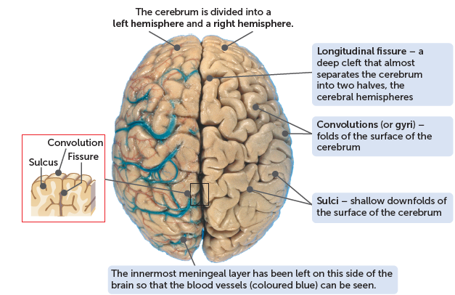
4.1 Central nervous system
Science Source/David Bassett
Convolutions, sulci and fissures of the cerebrum, as seen from above

Slide 9
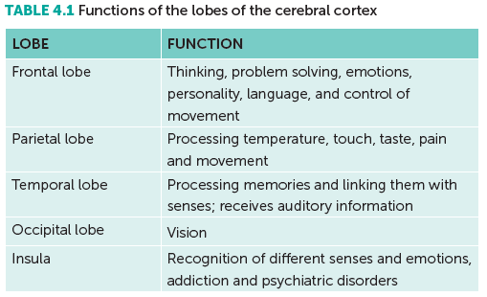
4.1 Central nervous system
Each cerebral hemisphere is divided into four lobes – the frontal, temporal, occipital and parietal lobes. Another part of the cerebrum, the insula, is deep inside the brain and is regarded as a fifth lobe.
The cerebral cortex is involved in mental activities such as thinking, reasoning, learning, memory and intelligence; and perception of the senses and the initiation and control of voluntary muscle contraction.

Slide 10
4.1 Central nervous system
The cortex can be roughly divided into three functional areas.
sensory areas, which interpret impulses from receptors
motor areas, which control muscular movements
association areas, which are concerned with intellectual and emotional processes.
One of the important functions of the cerebrum is memory. The association areas of the cerebral cortex are involved in memory.
Although the two sides of the cerebrum appear to be very similar, close inspection shows that they are not identical. Many specialised functions occur in only one hemisphere.

Slide 11
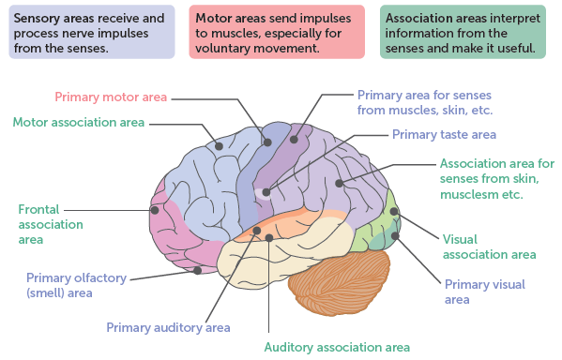
4.1 Central nervous system
Some functional areas of the cerebral cortex

Slide 12
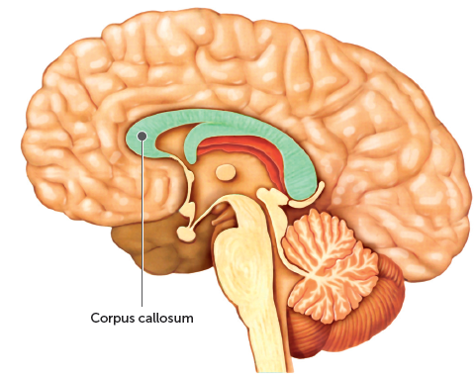
4.1 Central nervous system
Corpus callosum
The corpus callosum is a wide band of nerve fibres that lies underneath the cerebrum at the base of the longitudinal fissure. Nerve fibres in the corpus callosum cross from one cerebral hemisphere to the other and allow the two sides of the cerebrum to communicate with each other.
Shutterstock.com/illusmedical

Slide 13
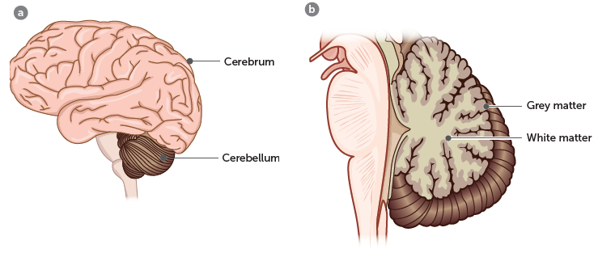
4.1 Central nervous system
Cerebellum
The cerebellum lies under the rear part of the cerebrum. It is the second largest part of the brain and its surface is folded into a series of parallel ridges. The outer folded part of the cerebellum is grey matter. Inside is white matter that branches to all parts of the cerebellum.
It is responsible for posture, balance and the fine coordination of voluntary muscle movement. All the functions of the cerebellum take place below the conscious level.

Slide 14
4.1 Central nervous system
Hypothalamus
The hypothalamus lies in the middle of the brain and cannot be seen from the outside. Although small, the hypothalamus controls many bodily activities, but it is mostly concerned with maintaining homeostasis.
Its functions include the regulation of:
the autonomic nervous system, including heart rate and blood pressure
body temperature
food and water intake
patterns of waking and sleeping
contraction of the urinary bladder
emotional responses, such as fear, anger, pleasure
the secretion of hormones and coordination of parts of the endocrine system; acting through the pituitary gland, the hypothalamus regulates metabolism, growth, reproduction and responses to stress.

Slide 15
4.1 Central nervous system
Medulla oblongata
The medulla oblongata is a continuation of the spinal cord. It is about 3 cm long and extends from just above the point where the spinal cord enters the skull. Many nerve fibres simply pass through the medulla going to or from the other parts of the brain, but it does have an important role in automatically adjusting body functions.
The medulla oblongata contains:
the cardiac centre, which regulates the rate and force of the heartbeat
respiratory centres, which control rate and depth of breathing
the vasomotor centre, which regulates the diameter of blood vessels.
In addition, other centres regulate the reflexes of swallowing, sneezing, coughing and vomiting.
All the centres in the medulla oblongata are influenced and controlled by higher centres in the brain, particularly the hypothalamus.

Slide 16
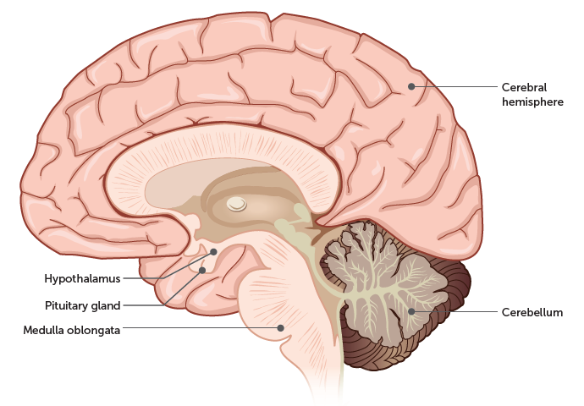
4.1 Central nervous system
Location of the hypothalamus and medulla oblongata

Slide 17
4.1 Central nervous system
Spinal cord
The spinal cord is a roughly cylindrical structure about 44 cm long in an adult. It extends from the foramen magnum to the second lumbar vertebra.
The cord is enclosed in the vertebral canal, and inside the ring of bone are the three meningeal layers.
The spinal cord consists of areas of grey matter in the centre and is surrounded by areas of white matter.
The grey matter contains the central canal, which runs the length of the spinal cord and contains cerebrospinal fluid.
The myelinated nerve fibres of the white matter are arranged in bundles known as ascending and descending tracts. Ascending tracts are sensory axons that carry impulses upwards, towards the brain. Descending tracts contain motor axons that conduct impulses downwards, away from the brain.
One of the functions of the spinal cord is to carry sensory impulses up to the brain and motor impulses down from the brain. The second function of the spinal cord is to integrate certain fast, automatic responses called reflexes.

Slide 18
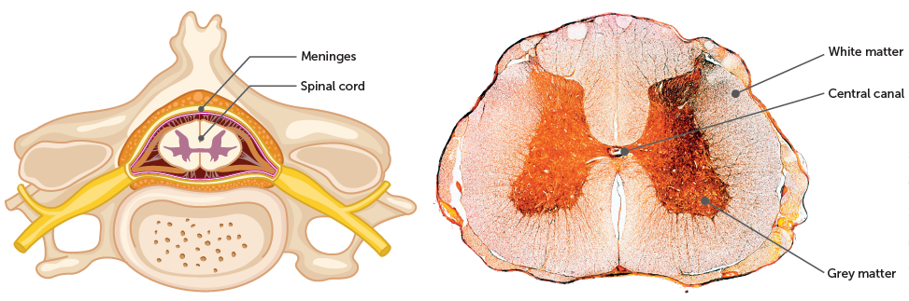
4.1 Central nervous system
Alamy Stock Photo/Science Photo Library
Cross-section of a vertebra showing the position of the spinal cord and meninges
Cross-section of the spinal cord seen under a microscope

Slide 19
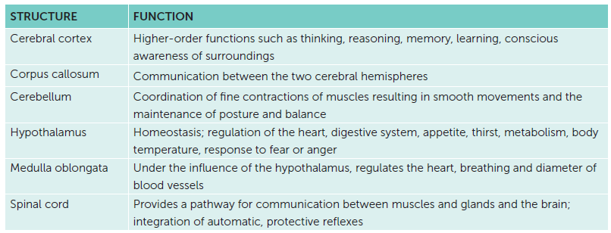
4.1 Central nervous system
Structure and functions of the main areas of the CNS

Slide 20
4.2 Peripheral nervous system
The peripheral nervous system (PNS) takes messages from receptors to the CNS and from the CNS to muscles and glands. It is composed of:
nerve fibres that carry information to and from the CNS
groups of nerve cell bodies, called ganglia, which lie outside the brain and spinal cord.
Types of nerves
The nerve fibres are arranged into nerves, which arise from the brain and the spinal cord.

Slide 21
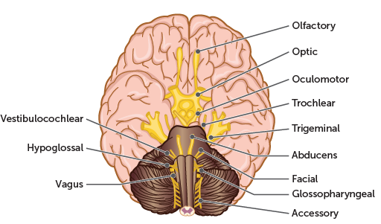
4.2 Peripheral nervous system
Cranial nerves
Twelve pairs of cranial nerves arise from the brain. Most cranial nerves are mixed nerves; they contain fibres that carry impulses into the brain, as well as fibres that carry impulses away from the brain. Fibres that carry impulses into the CNS are called sensory fibres; those that carry impulses away from the CNS are motor fibres.

Slide 22
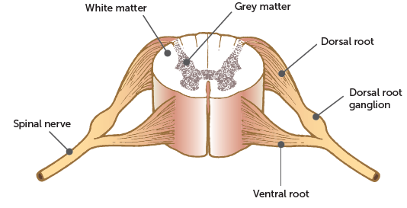
4.2 Peripheral nervous system
Spinal nerves
31 pairs of spinal nerves arise from the spinal cord. They are all mixed nerves containing both sensory and motor fibres. Each nerve is joined to the spinal cord by two roots. The ventral root contains the axons of motor neurons that have their cell bodies in the grey matter of the spinal cord.
The dorsal root contains the axons of sensory neurons that have their cell bodies in a small swelling on the dorsal root known as the dorsal root ganglion.

Slide 23
4.2 Peripheral nervous system
Divisions of the PNS
The nerves that make up the PNS contain fibres carrying nervous impulses to and from all parts of the body. The PNS is divided into parts, each with a particular function.
Afferent division
The afferent (or sensory) division of the PNS has fibres that carry impulses into the CNS by sensory neurons from receptors in the skin and around the muscles and joints. These neurons can be further divided into:
• somatic sensory neurons, which bring impulses from the skin and muscles
• visceral sensory neurons, which bring impulses from the internal organs.

Slide 24
4.2 Peripheral nervous system
Efferent division
The efferent (or motor) division has fibres that carry impulses away from the CNS. It is subdivided into:
• the somatic division (sometimes called the somatic nervous system), which takes impulses from the CNS to the skeletal muscles
• the autonomic division (autonomic nervous system), which carries impulses from the CNS to heart muscle, involuntary muscles and glands. The autonomic division is further subdivided into the:
– sympathetic division (sympathetic nervous system)
– parasympathetic division (parasympathetic nervous system).

Slide 25
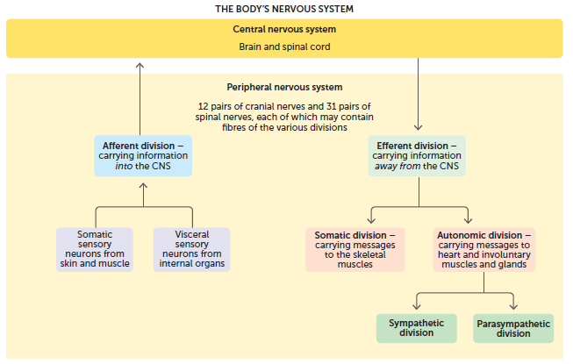
4.2 Peripheral nervous system

Slide 26
4.2 Peripheral nervous system
Autonomic nervous system (ANS)
The ANS controls the body’s internal environment and is involved in many of the mechanisms that keep it constant. It usually operates without conscious control and is regulated by groups of nerve cells in the medulla oblongata, hypothalamus and cerebral cortex. Some of the body functions regulated by the autonomic division include:
• heart rate
• blood pressure
• body temperature
• digestion
• release of energy
• pupil diameter
• air flow to the lungs
• defecation
• urination.

Slide 27
4.2 Peripheral nervous system
The nerve fibres of the ANS make up part of the spinal nerves and part of some of the cranial nerves. They carry impulses to the heart muscle, other muscles of the internal organs and the glands.
The impulse travels along two neurons from the CNS to an organ controlled by the ANS. The first neuron is myelinated and has its cell body in the CNS. The second neuron is unmyelinated and has its cell body in a ganglion.
The pathway from the CNS to heart muscle, involuntary muscle or glands is an important difference between the autonomic division and the somatic division. Where there are two motor neurons involved in the autonomic pathway, the somatic division has just one motor neuron carrying impulses from the CNS to the effector.

Slide 28
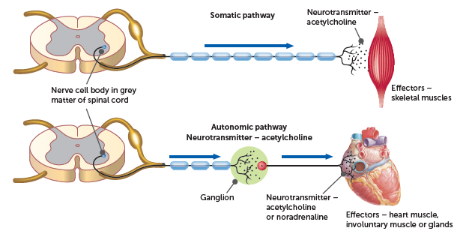
4.2 Peripheral nervous system
The difference in motor pathways between the autonomic and somatic divisions of the PNS

Slide 29
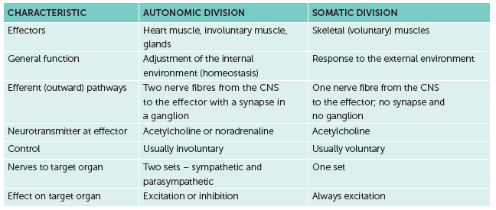
4.2 Peripheral nervous system
Comparison of the autonomic and somatic divisions of the PNS

Slide 30
4.2 Peripheral nervous system
Fight-or-flight response
In threatening situations the sympathetic becomes dominant. Situations that involve fear, anger, stress, danger or competition provoke the fight-or-flight response or alarm reaction, which prepares the body for increased activity.
• The rate and force of contraction of the heart increase, with a consequent increase in blood pressure.
• Blood vessels dilate in organs involved in strenuous activity, such as the skeletal muscles, heart and liver.
• Blood vessels constrict in organs not involved in activity, such as the kidney, stomach, intestines and skin.
• Airways in the lungs dilate and the rate and depth of breathing increases.
• Blood glucose level rises, because the liver converts more glycogen into glucose.
• Secretion from sweat glands increases.
• The adrenal medullae release the hormones adrenaline and noradrenaline, which intensify and prolong the above responses.

Slide 31
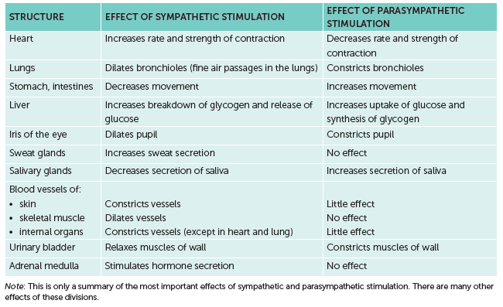
4.2 Peripheral nervous system
Summary of the effects of the autonomic nervous system

